Slide 1


DESKTOP AUTOMATION FRAMEWORK
05/2023

Slide 2


TABLE OF CONTENTS
01.
04.
06.
PURPOSE
FLAUI & FLAUINSPECT
REPORTING & CI/CD
02.
05.
07.
FRAMEWORK ECOSYSTEM
POM & TDD
DEMO
03.
FRAMEWORK STRUCTURE

Slide 3


PURPOSE

Slide 4


PURPOSE
Build a framework to automate test cases for multi-type of Desktop Application.
Utilizing a framework for automated testing will increase a team's test speed and efficiency, improve test accuracy, and will reduce test maintenance costs as well as lower risks
Have ability to extend with others test management system (Zephyr Scale), reporting tools (Allure report, Reportportal.io), and execute tests with CI/CD
Apply Page Object Model design pattern (POM) and Data-Driven Testing (DDT) reduce code duplication and improves test case maintenance, useful for tests that have a similar structure but use different data

Slide 5
FRAMEWORK ECOSYSTEM

Slide 6
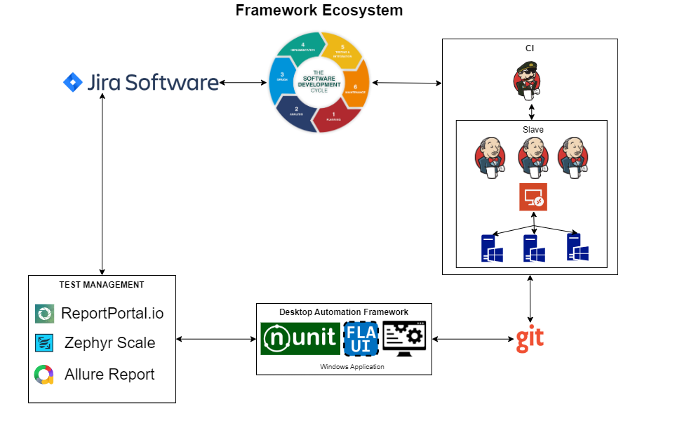
FRAMEWORK ECOSYSTEM

Slide 7
FRAMEWORK STRUCTURE

Slide 8
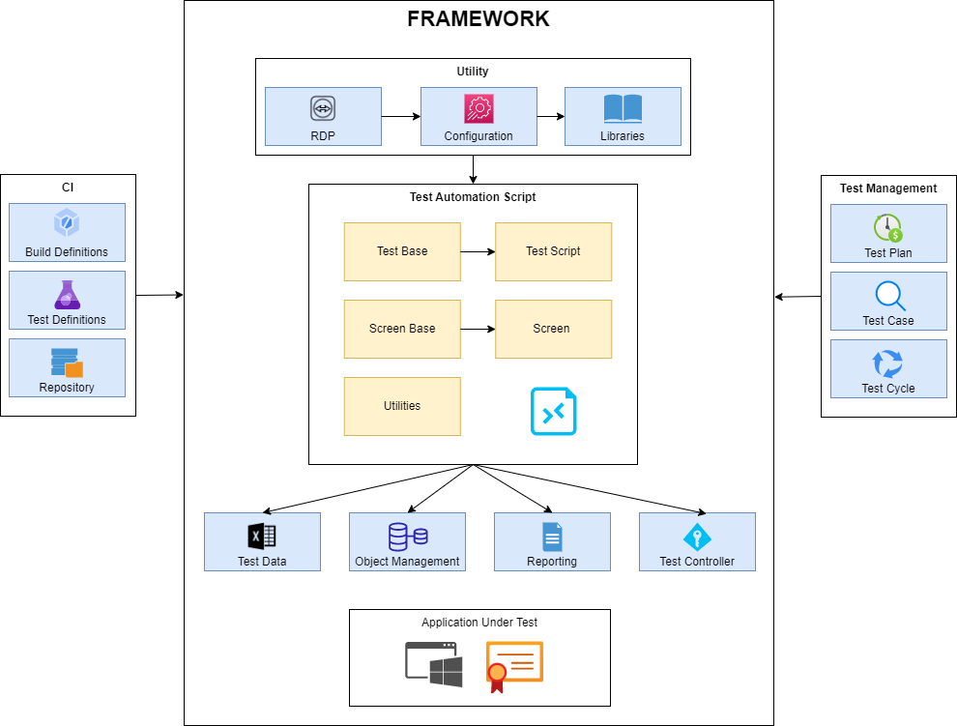
FRAMEWORK STRUCTURE

Slide 9
FLAUI & FLAUINSPECT

Slide 10
DIFFERENCE TYPE OF WINDOWS APPLICATION
UIA2 is a managed library for native UI Automation API that was introduced in .NET Framework 3.0. It does not support newer features such as touch and it also does not work well with WPF or Windows Store Apps.
UIA3 is a COM library for native UI Automation API that was introduced in Windows 7. It works great for WPF and Windows Store Apps
FlaUI is a UI automation library for .NET that helps with automated testing of Windows applications based on native UI Automation libraries from Microsoft and supports two versions of them: UIA2 and UIA3.
UIA2
UIA3
FlaUI

Slide 11
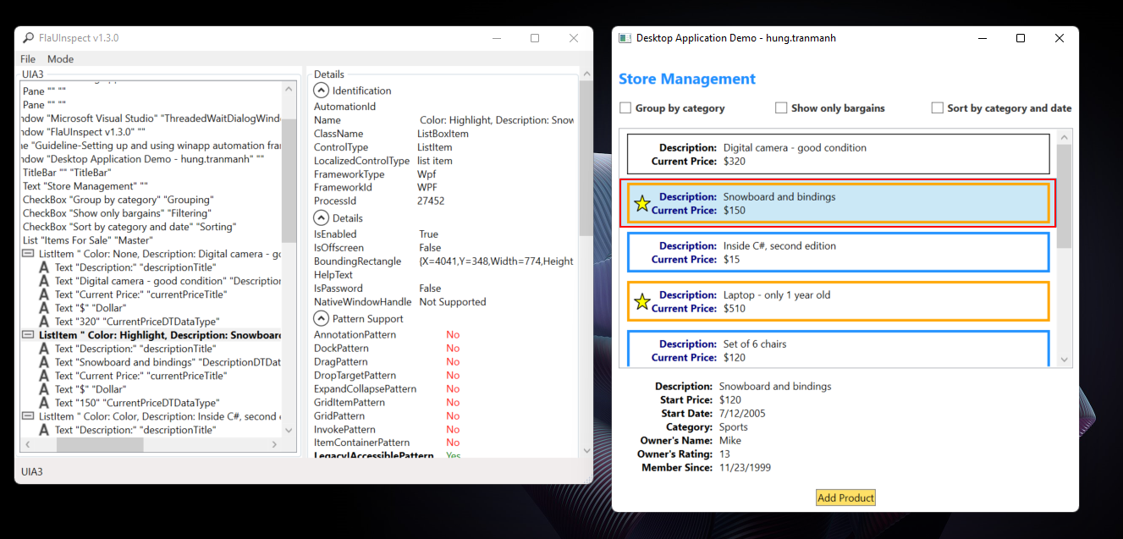
FLAUINSPECT

Slide 12
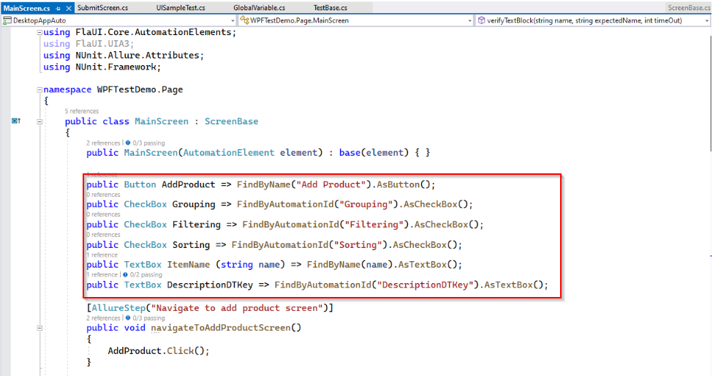
FLAUINSPECT

Slide 13
POM & TDD

Slide 14
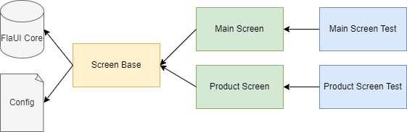
PAGE OBJECT MODEL DESIGN PATTERN

Slide 15
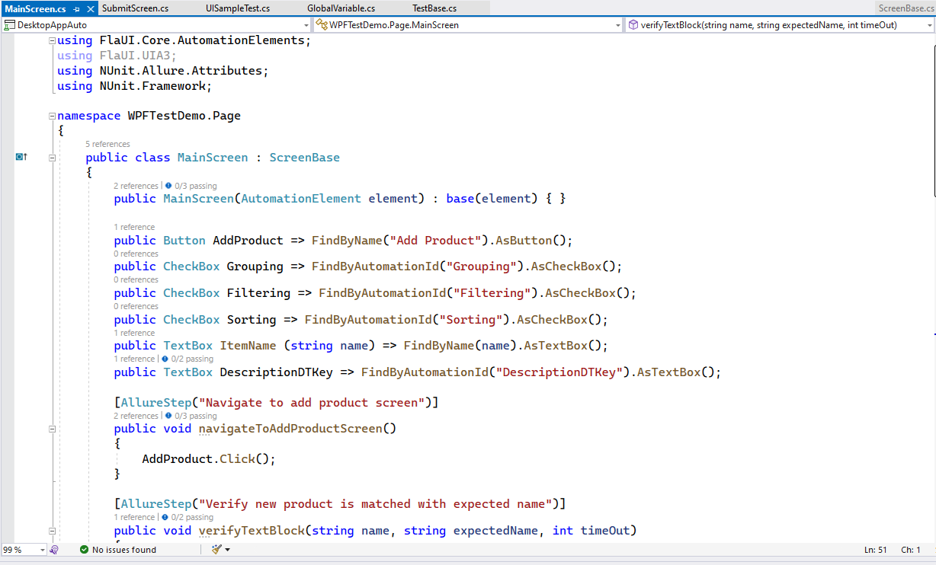
PAGE OBJECT MODEL DESIGN PATTERN

Slide 16
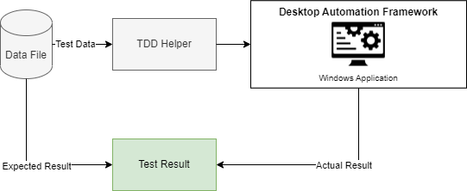
DATA-DRIVEN TESTING(DDT)

Slide 17
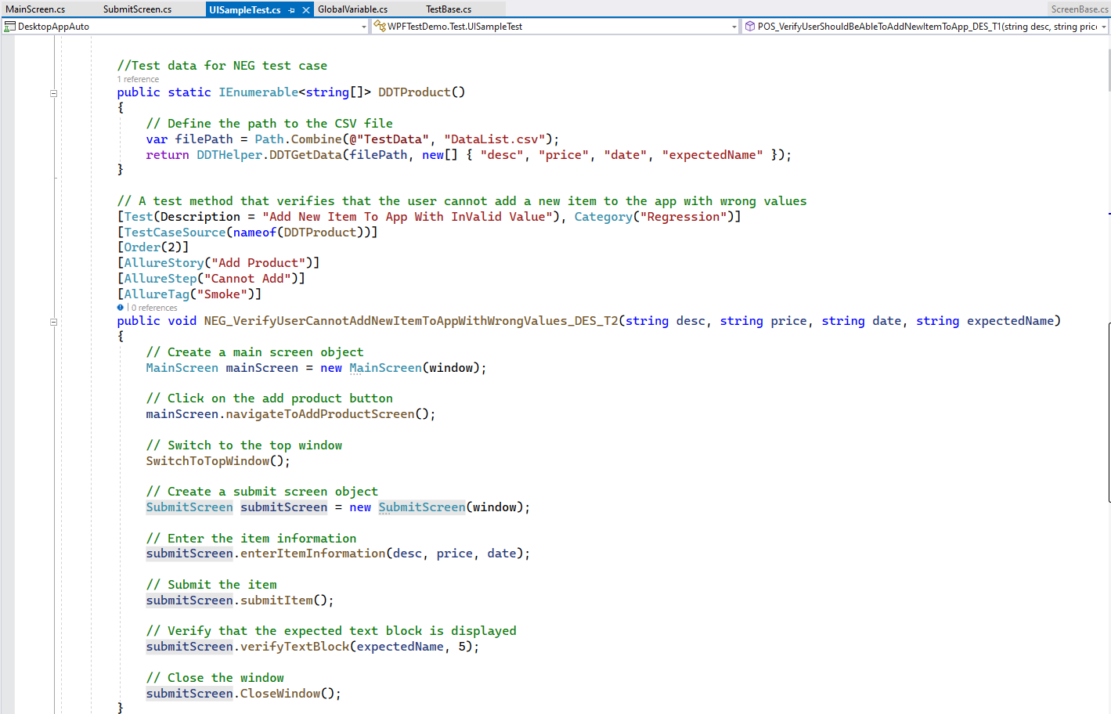
DATA-DRIVEN TESTING(DDT)

Slide 18
REPORTING & CI/CD

Slide 19
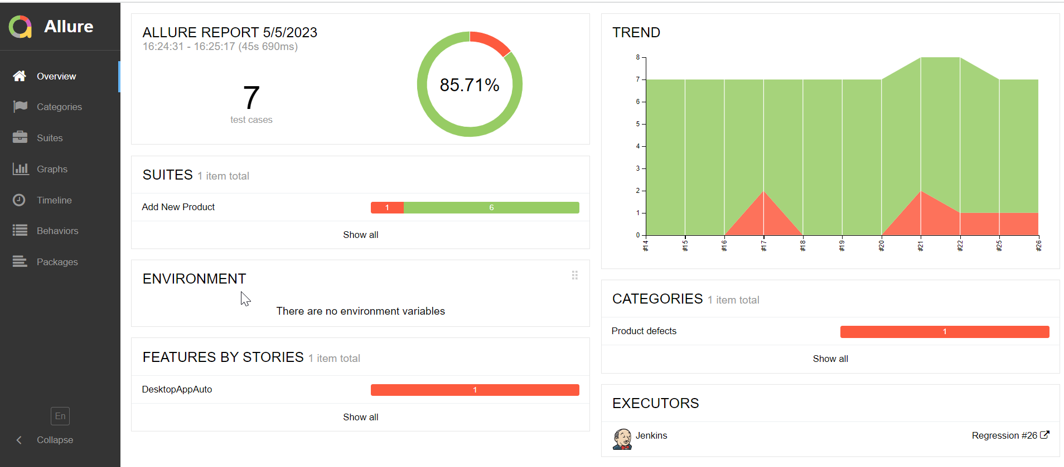
REPORTING – ALLURE REPORT
Notes:
Categories
Report pass/fail
Capture screenshot for failed test case
Tracking success rate for each test case

Slide 20
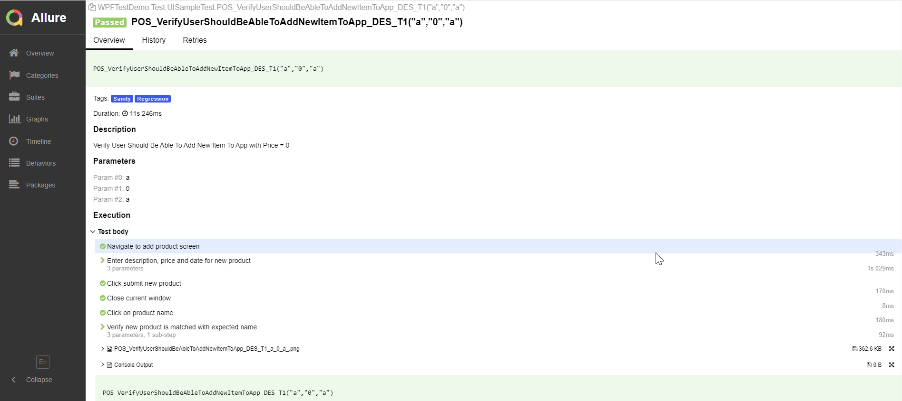
REPORTING – ALLURE REPORT
Notes:
Detail test case summary
Step summary
Screenshot for failed test case
Parameter for test cases

Slide 21
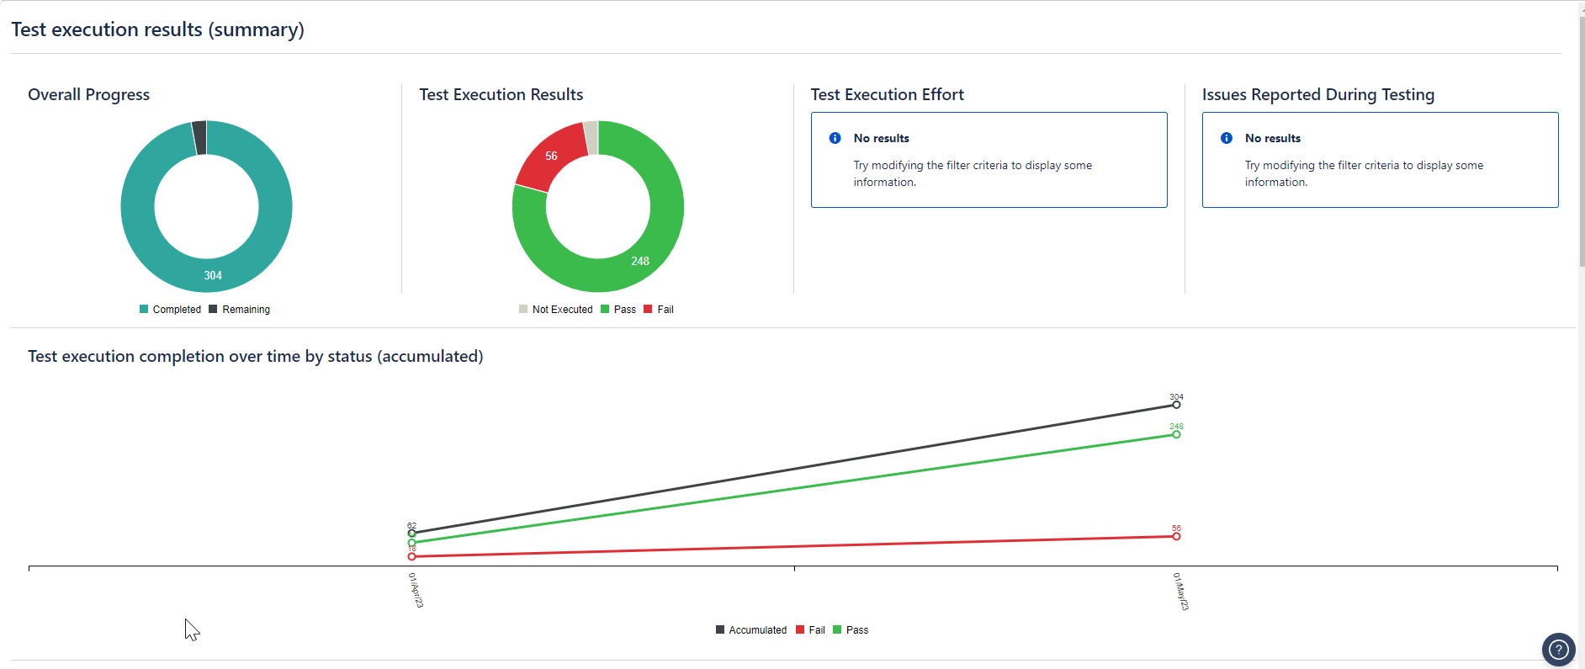
REPORTING – ZEPHYR REPORT
Notes:
Tracking for both manual and automation test

Slide 22
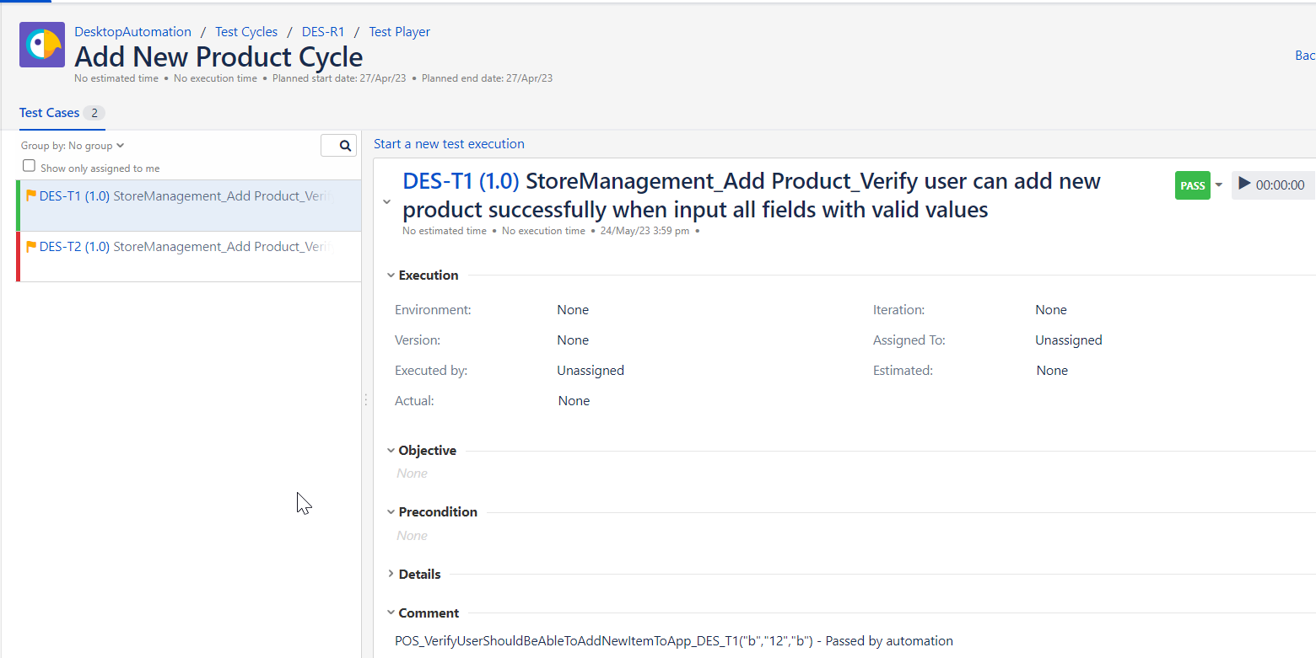
REPORTING – ZEPHYR REPORT

Slide 23
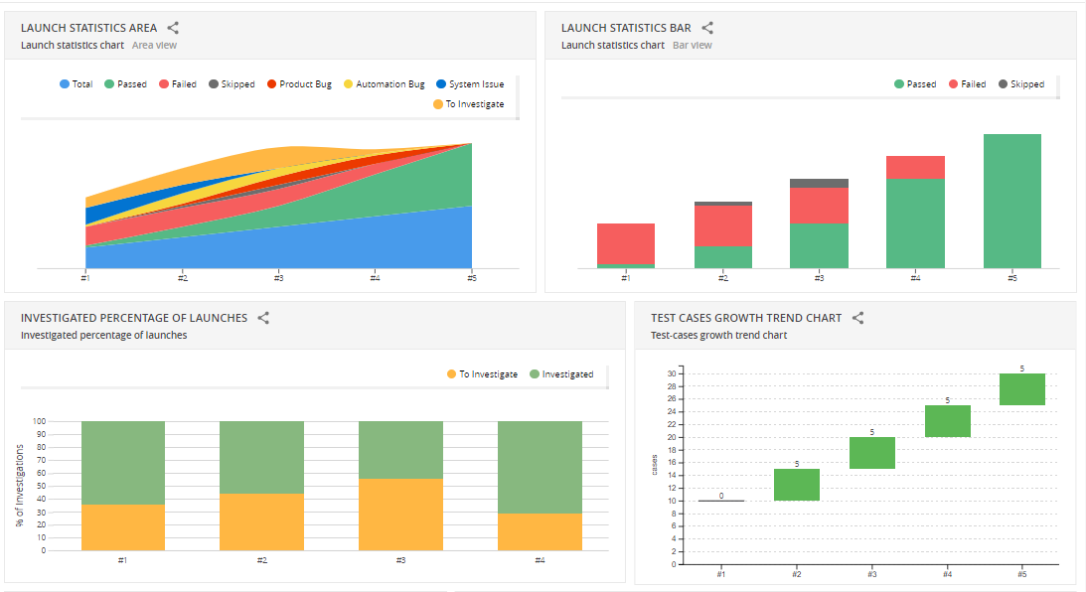
REPORTING – REPORTPORTAL.IO
Notes:
Tracking for both manual and automation test

Slide 24
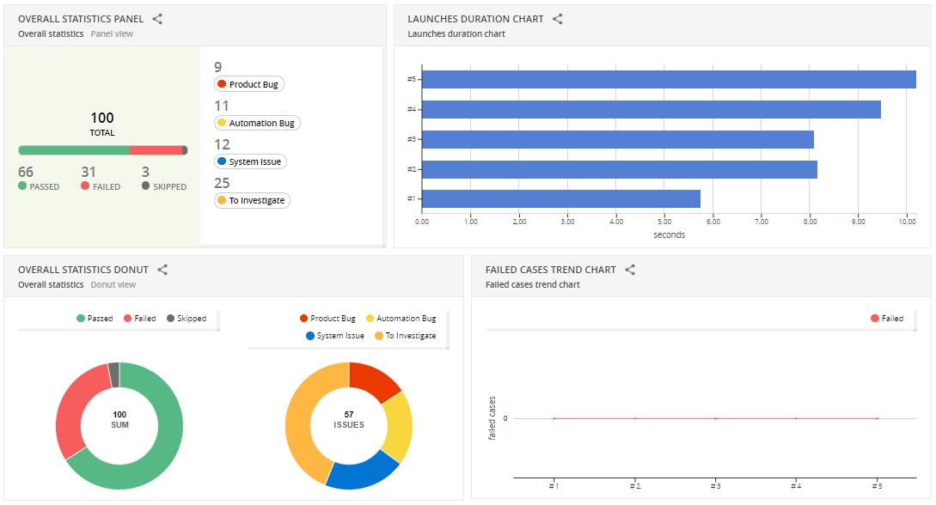
REPORTING – REPORTPORTAL.IO

Slide 25
DEMO

